Slide 1
Runner

Slide 2


Slide 3
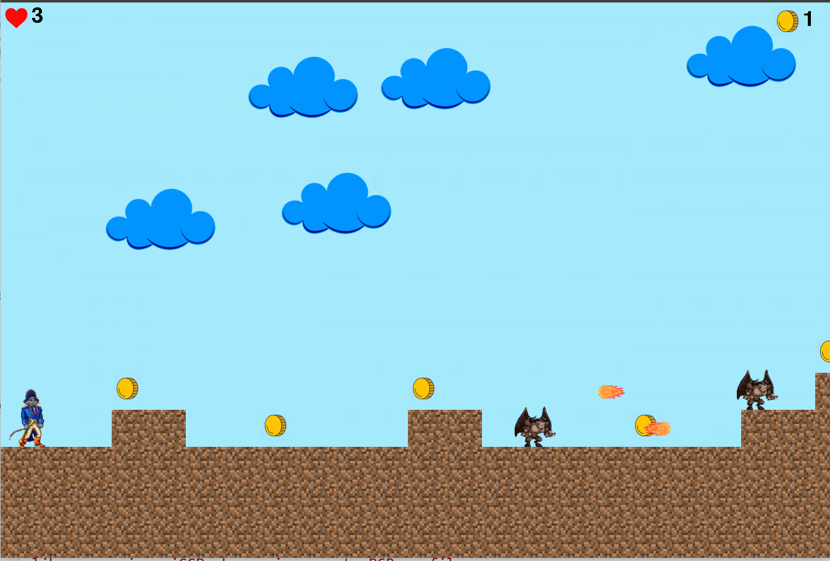

Slide 4
